Slide 1
Why Do Employers Need Compliancedashboard?
Know Your
Compliance
Obligations
Are You Prepared For ERISA Compliance and Health Care Reform?
It is crucial that you begin preparing now to be in full compliance with the new requirements and employer obligations.
Time to develop or retool your compliance strategy!
Minimize
Your Risks

Slide 2
Why Do Employers Need Compliancedashboard?
Know Your
Compliance
Obligations
Did you know…
The DOL has estimated that three out of four plans they audit have had an ERISA violation?
Minimize
Your Risks

Slide 3
Why Do Employers Need Compliancedashboard?
Know Your
Compliance
Obligations
Did you know…
The DOL plans to substantially increase the number of ERISA compliance audits it conducts each year?
Minimize
Your Risks

Slide 4
Why Do Employers Need Compliancedashboard?
Know Your
Compliance
Obligations
You need to know…
As a plan sponsor, you are an ERISA Fiduciary and held to one of the highest standards under the law.
The plan sponsor is also typically the ERISA Plan Administrator with direct responsibility for most items of legal compliance.
Fiduciary = Liability
Minimize
Your Risks

Slide 5
Why Do Employers Need Compliancedashboard?
Know Your
Compliance
Obligations
You need to know…
The cost of ERISA compliance in 2013 will continue to increase as Health Care Reform comes into full swing.
Minimize
Your Risks

Slide 6
Why Do Employers Need Compliancedashboard?
Compliance Obligations in 2013
Plan Admin/Fiduciary Liability
Prepare/Distribute Notices
Summary of Benefits and Coverage
Summary Annual Report
Women’s Health and Cancer Rights Act Notice
Children’s Health Insurance Program Notice
HIPAA Preexisting Condition Exclusion Notice
HIPAA Certificates of Creditable Coverage
HIPAA Notice of Privacy Practices
HIPAA Preexisting Condition Exclusion Notice
HIPAA Special Enrollment Notice
Medicare Part D Creditable Coverage Notice
Notice of the Health Benefit Exchange
Patient Protections Disclosure
USERRA Rights Notice Reporting & Disclosure
COBRA
Administration and monitoring
Participant tracking
Eligibility compliance
Send/document notices
Research and Education
Working Families Tax Relief Act
FMLA Continuation of Coverage
On-Site Clinic ERISA Compliance
ERISA Safe Harbor Delivery Methods
Employee and Dependent Eligibility Requirements
Nondiscrimination Rules (beyond HIPAA)
Maintaining Grandfathered Plan Status Disclosure
HIPAA Privacy & Security
Implement/Review policies and procedures
Risk assessment/breach notification procedures
Implement/Review administrative, technical and physical safeguards
Audit plan documentation
Workforce training
Prepare Disclosure Language/Materials
Qualified Medical Child Support Orders
Newborns’ Protection Act
HIPAA Nondiscrimination
Grandfathered Plan Status
Audit Plan Provisions
Recordkeeping Requirements
Mental Health Parity Act
Subrogation
Claim Procedures
Prohibition of preexisting condition exclusions for enrollee’s under 19
Prohibition of annual and lifetime dollar limits
Prepare Forms/Report to Government
Form 5500
Creditable Coverage to CMS
W-2 Reporting
Patient-Centered Outcomes Research Institute (PCORI) fee
Quality of Care Reporting
Prepare/Distribute Plan Documents
Plan
Summary Plan Description
Summary of Material Modifications
Notice of Plan Modifications
Cafeteria Plan
Bonding Requirements
Every person who handles plan assets

Slide 7
Why Do Employers Need Compliancedashboard?
Know Your
Compliance
Obligations
You need to know…
The DOL is expected to make aggressive enforcement a part of its compliance reform.
Health Care Reform will be a special focus of the DOL audit staff
Ignorance ≠ Accepted Excuse
Minimize
Your Risks

Slide 8
Why Do Employers Need Compliancedashboard?
You need to know…
What the fines look like:
Failure to file a Form 5500 = up to $1,100/day/plan
Willful failure to timely provide an SPD = up to $1,000
General ERISA & PHSA Penalties, charges amount to up to $110/day/occurrence
Excise taxes must be paid for many compliance failures
Know Your
Compliance
Obligations
Minimize
Your Risks

Slide 9
Why Do Employers Need Compliancedashboard?
Know Your
Compliance
Obligations
You need to know…
Participants, beneficiaries, and fiduciaries can file lawsuits to enforce ERISA.
Lawsuits arising from benefit denials often hinge on compliance obligations.
Minimize
Your Risks

Slide 10
Why Do Employers Need Compliancedashboard?
Know Your
Compliance
Obligations
You need to know…
While third-party administrators and insurance companies often help with compliance, it is not comprehensive and gaps inevitably result.
The plan sponsor remains liable when obligations are not satisfied, no matter who performs them.
Minimize
Your Risks

Slide 11
Compliancedashboard can help.
Compliancedashboard is the leading web-based solution for helping employers comply with the federal laws that govern health & welfare plans.
We make it simple.

Slide 12
Compliancedashboard can help.
We stand ready to incorporate all new regulations that arise from Health Care Reform into this user-friendly web technology that is currently used by thousands of employers to fulfill their compliance obligations.
We make it simple.

Slide 13
Compliancedashboard can help.
Compliancedashboard solves the four most common problems employers face when managing compliance:
Where do I find the information I need?
What do I do and when do I do it?
Who will make sure it gets done?
How do I document our compliance efforts?
We make it simple.

Slide 14
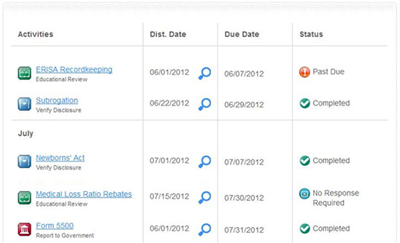
Compliancedashboard benefits.
Turnkey process for monitoring compliance obligations

Slide 15
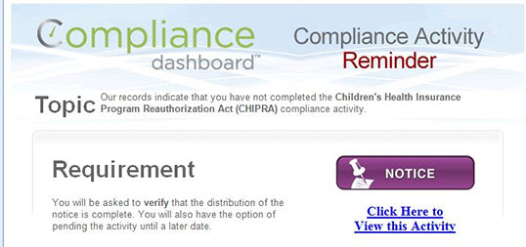
Compliancedashboard benefits.
On-time reminder system to ensure nothing is overlooked

Slide 16
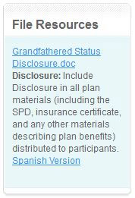
Compliancedashboard benefits.
Plan specific requirements save time and resources

Slide 17
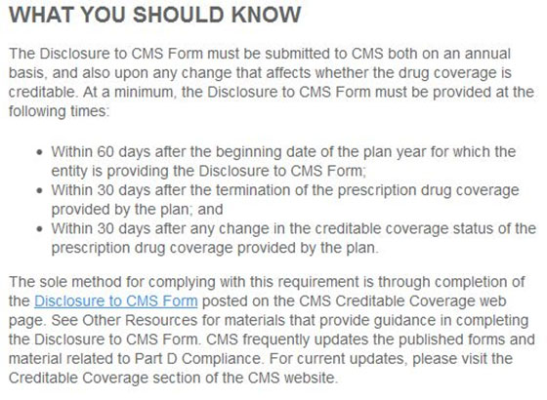
Compliancedashboard benefits.
Concise requirement descriptions written in plain English

Slide 18
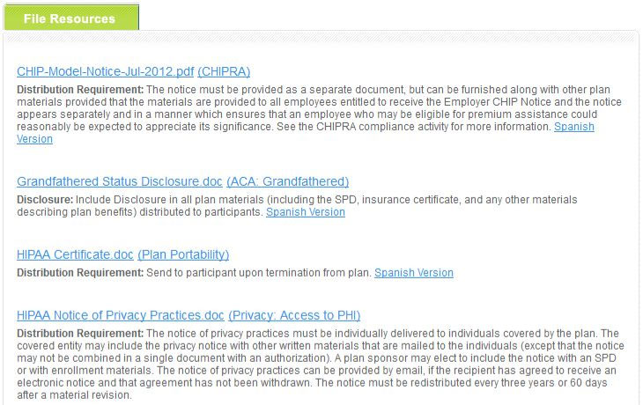
Compliancedashboard benefits.
Sample notices and distribution guidelines

Slide 19
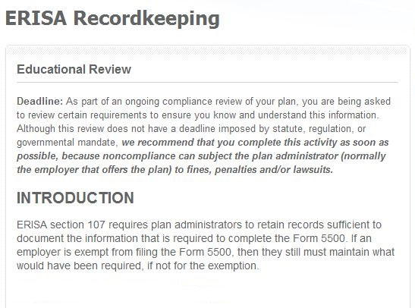
Compliancedashboard benefits.
Educational review of important topics

Slide 20
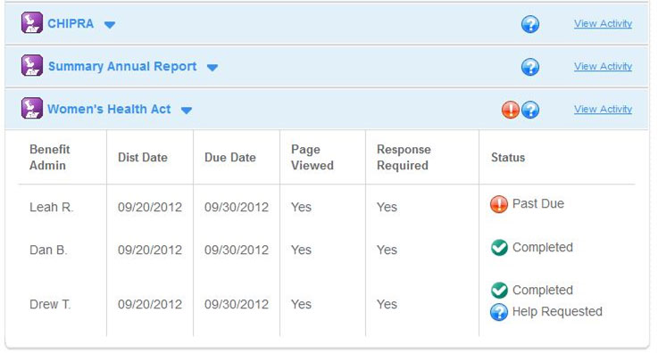
Compliancedashboard benefits.
Managerial oversight of compliance tasks to minimize risks

Slide 21
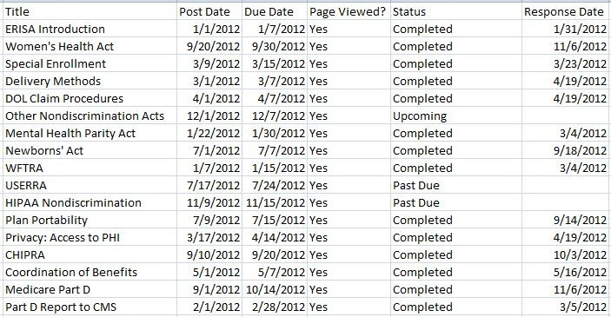
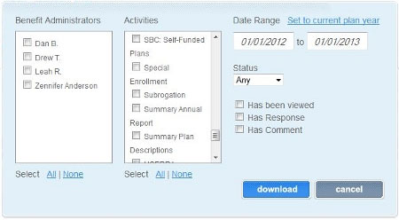
Compliancedashboard benefits.
On-demand audit reports provide necessary documentation

Slide 22
Compliancedashboard can help.
Simply Put, We Help You Simplify Compliance
Compliancedashboard will take work off your desk, improve your compliance processes and help relieve anxiety over Health Care Reform.
Let us show you how we make it simple.
We make it simple.

